Slide 1
CSM104: Analog and Digital Electronics
YEAR 1
LECTURER: Dr. Alfred UWITONZE
CONTACTS: Phone number: 0788549588
E-mail: alfruwitonze@gmail.com
Academic Year 2022-2023

Slide 2
INTRODUCTION
This module is made of three main units: Fundamentals of Electricity, Analog Electronics and Digital Electronics.
It gives an introduction to analysis of elementary analog and digital circuits. It will give a basis for understanding and constructing simple systems of analog and digital electronic circuit elements.
Central themes: Current and voltage, Kirchhoff's laws, methods of analysis for liner static circuits, resistance, capacitance, inductance, diodes, MOSFET transistor as a switch, operational amplifiers, transient analysis, binary arithmetic, boolean algebra, logic gates, combinatorial and sequential digital circuits.

Slide 3
INTRODUCTION
GRADING
CAT 1 (3 Assignements): 30%
CAT 2: 30%
FAT: 40%

Slide 4
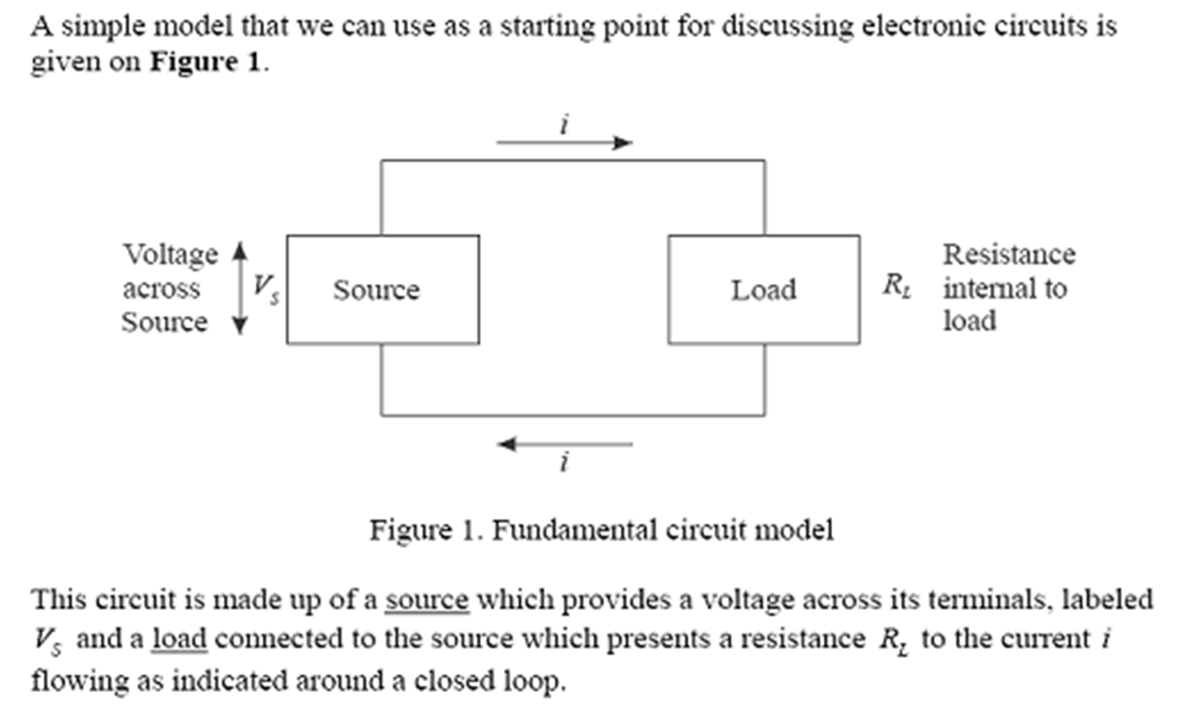
UNIT 1: Fundamentals of Electricity
DC Circuits

Slide 5
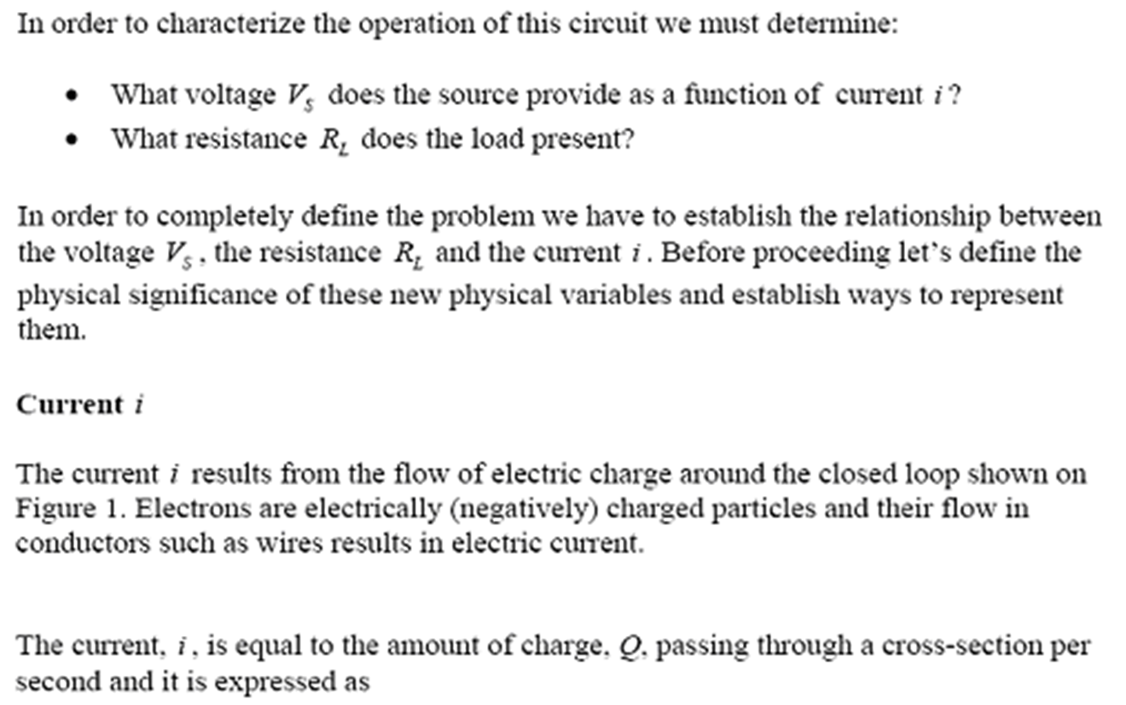
UNIT 1: Fundamentals of Electricity
DC Circuits

Slide 6
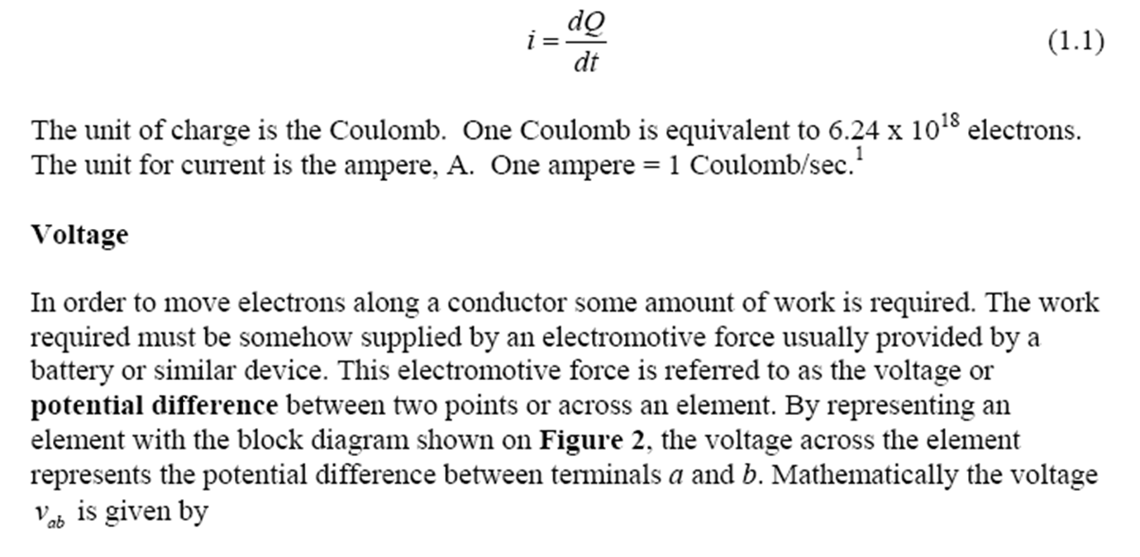
UNIT 1: Fundamentals of Electricity
DC Circuits

Slide 7
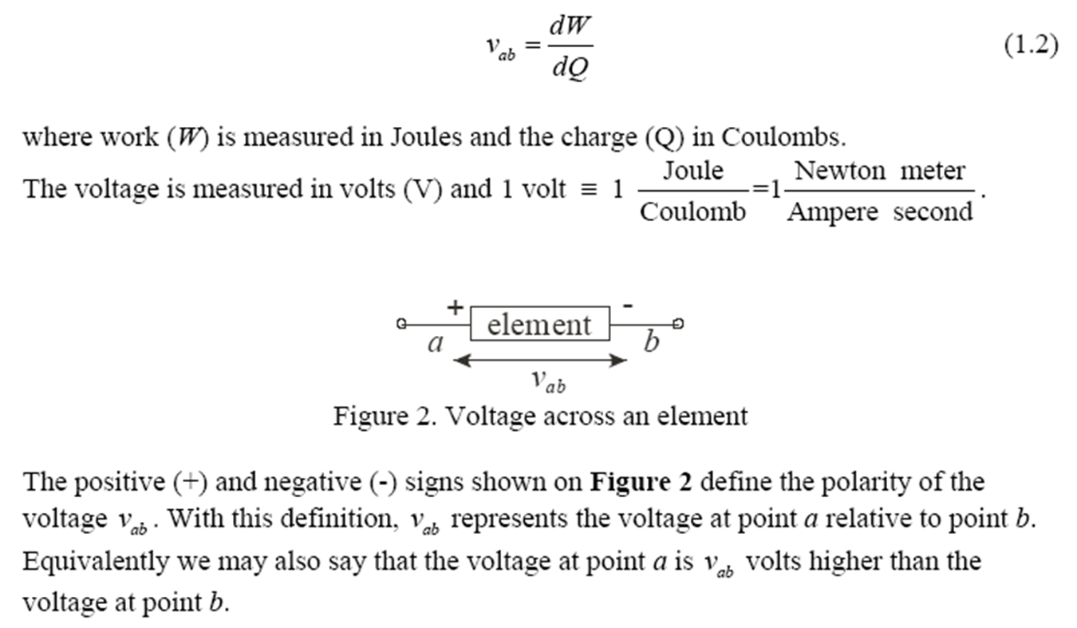
UNIT 1: Fundamentals of Electricity
DC Circuits

Slide 8
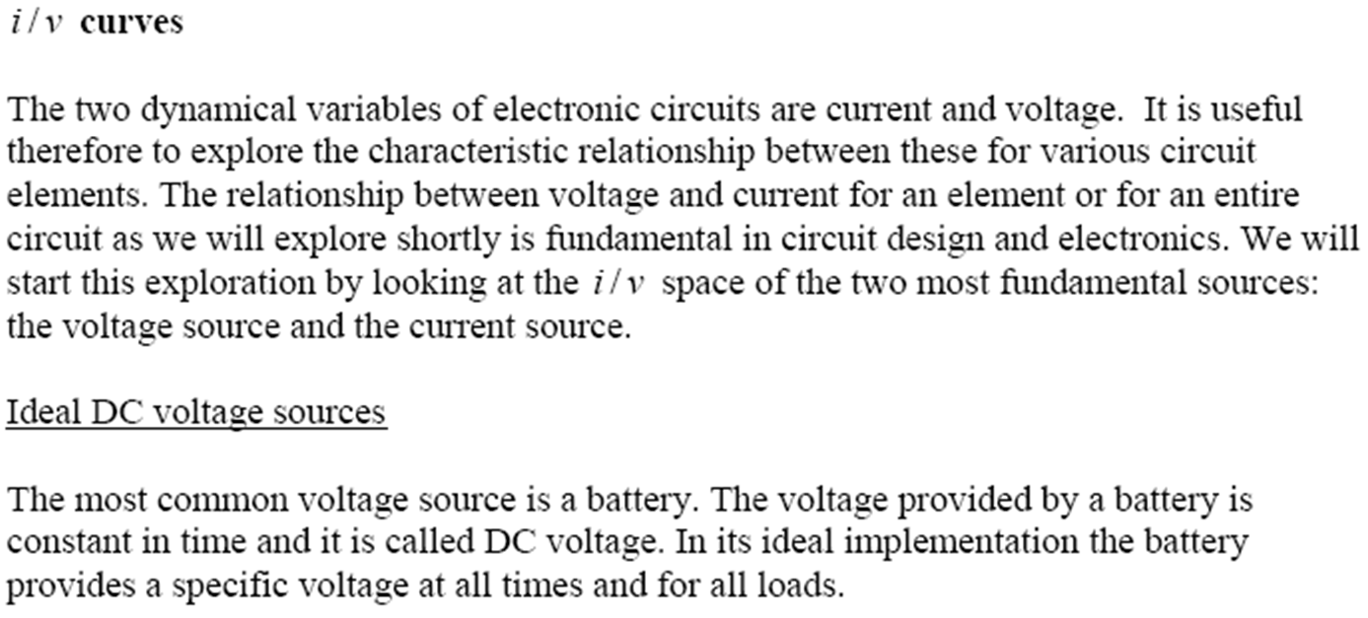
UNIT 1: Fundamentals of Electricity
DC Circuits

Slide 9
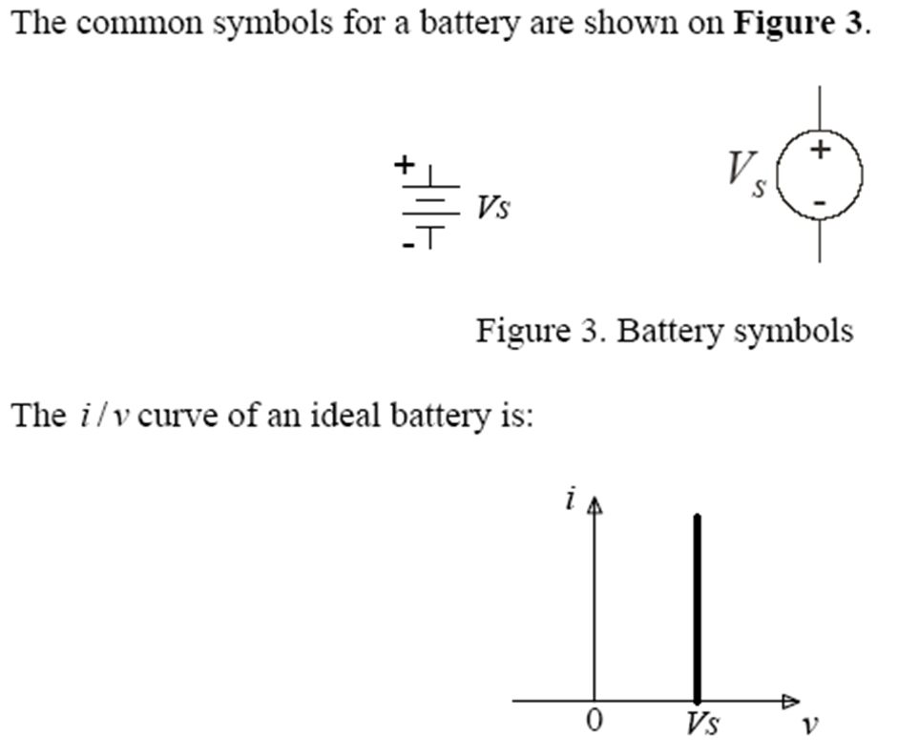
UNIT 1: Fundamentals of Electricity
DC Circuits

Slide 10
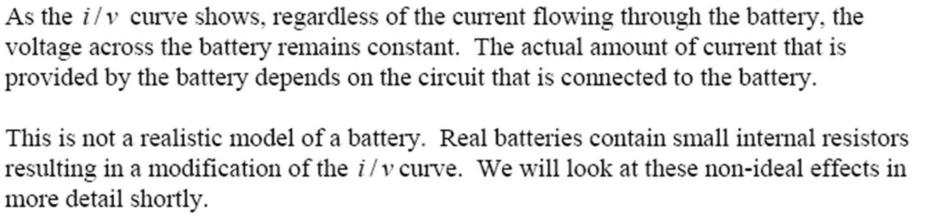
UNIT 1: Fundamentals of Electricity
DC Circuits

Slide 11
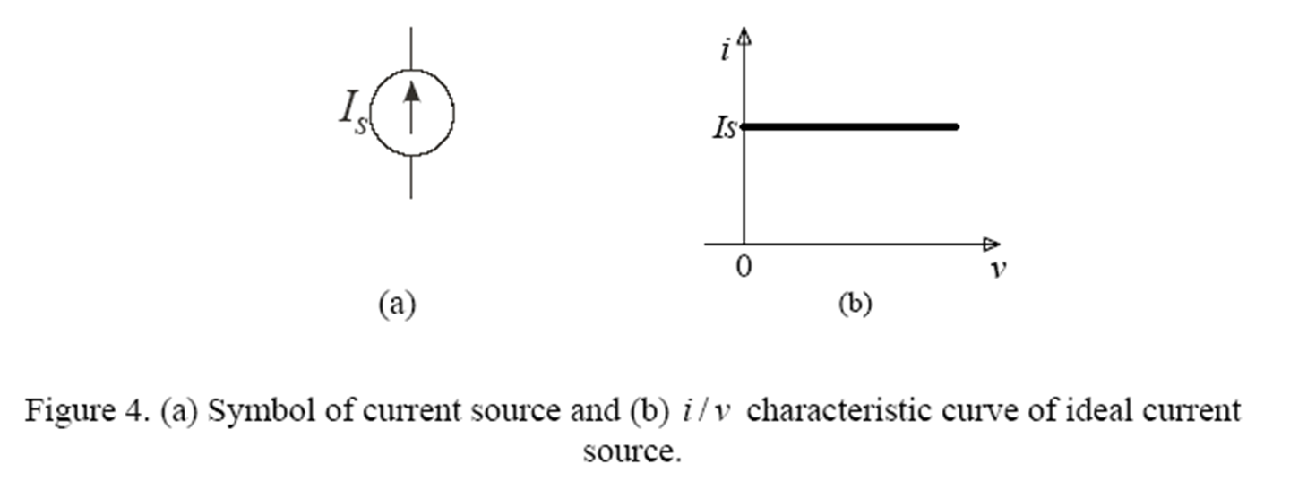
UNIT 1: Fundamentals of Electricity
DC Circuits

Slide 12
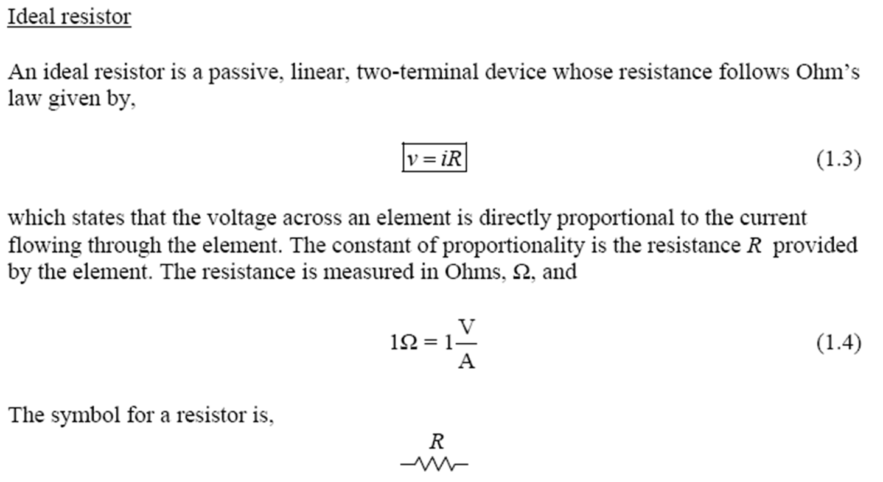
UNIT 1: Fundamentals of Electricity
DC Circuits

Slide 13
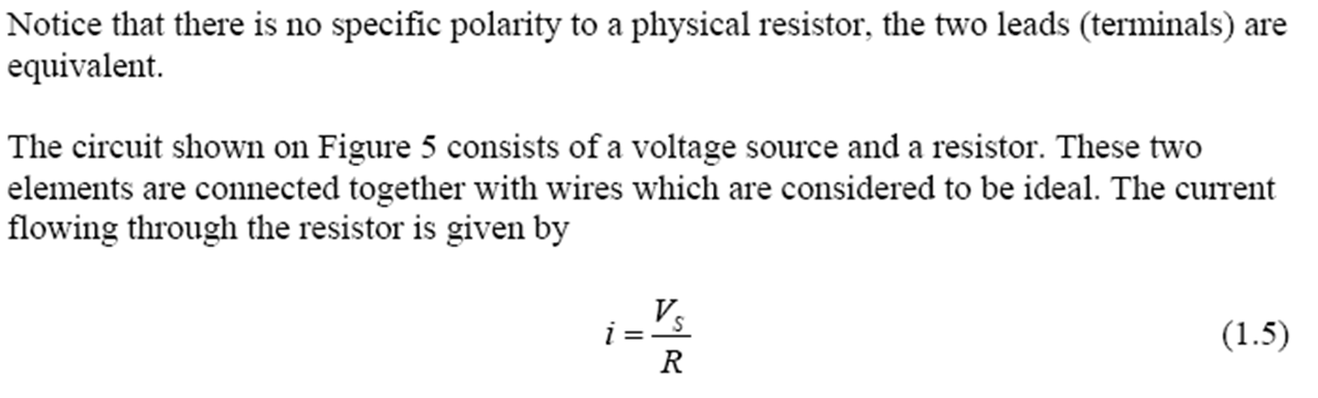
UNIT 1: Fundamentals of Electricity
DC Circuits

Slide 14
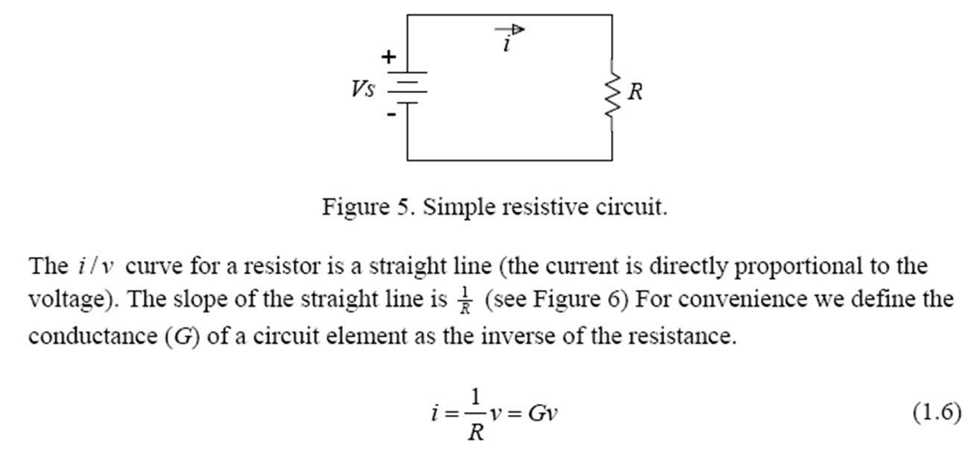
UNIT 1: Fundamentals of Electricity
DC Circuits

Slide 15
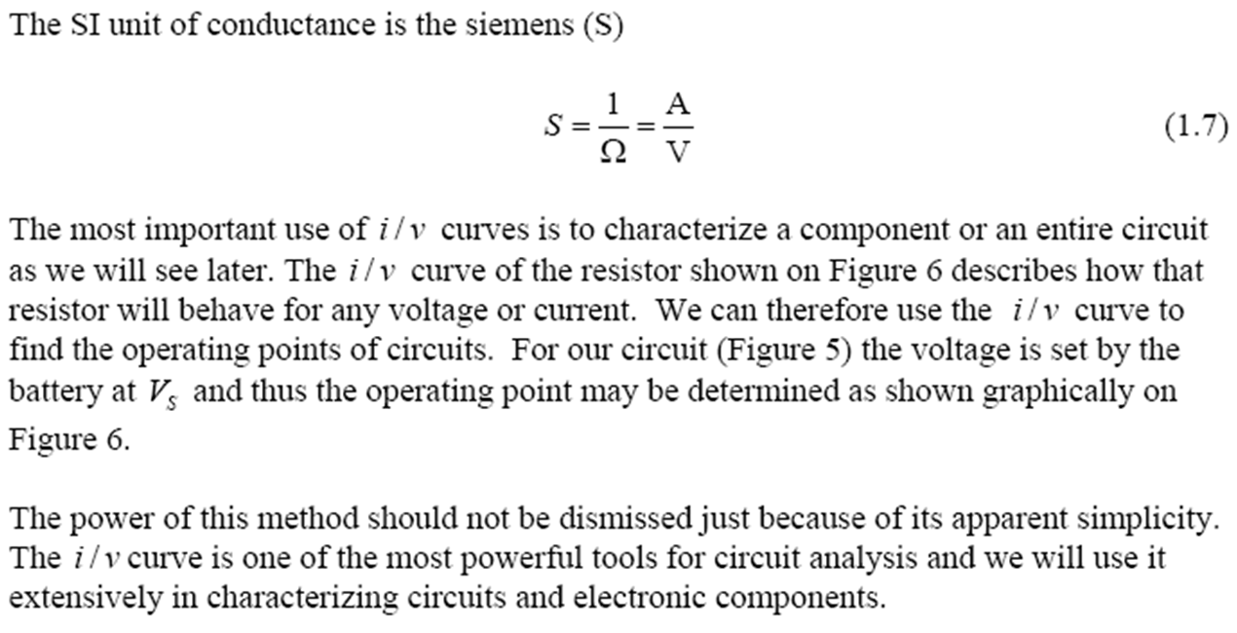
UNIT 1: Fundamentals of Electricity
DC Circuits

Slide 16
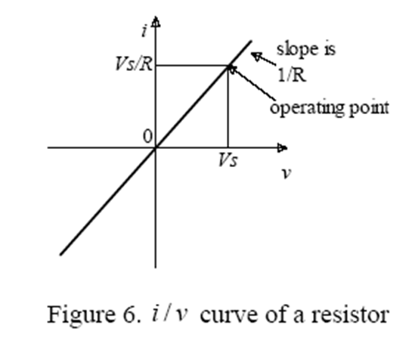
UNIT 1: Fundamentals of Electricity
DC Circuits

Slide 17
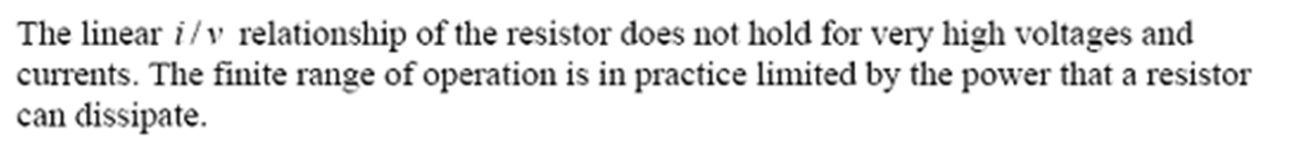
UNIT 1: Fundamentals of Electricity
DC Circuits

Slide 18
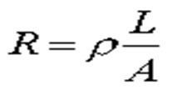
UNIT 1: Fundamentals of Electricity
DC Circuits
Resistivity
The resistivity r is an intrinsic property of a material, like density or specific heat. For wire of cross section A, the resistance is:
where L is the length of the material and A is the cross-sectional area. If the wire has more cross section, you get more current. If the wire is longer, you get less current.

Slide 19
UNIT 1: Fundamentals of Electricity
DC Circuits
Conductivity
Conductivity is the reciprocal (inverse) of electrical resistivity and has the SI units of siemens per metre (S·m⁻¹) i.e. if the electrical conductance between opposite faces of a 1-metre cube of material is 1 siemens then the material's electrical conductivity is 1 siemens per metre. Electrical conductivity is commonly represented by the Greek letter σ, but κ or γ are also occasionally used.
Electrical conductivity or specific conductivity is a measure of a material's ability to conduct an electric current. When an electrical potential difference is placed across a conductor, its movable charges flow, giving rise to an electric current. The conductivity σ is defined as the ratio of the current density J to the electric field strength E:
J= σE

Slide 20
UNIT 1: Fundamentals of Electricity
DC Circuits
Conductivity
Example #1
A wire of length L = 60 m needs to be laid to carry a current of 150 amps with a voltage drop of no more than 0.5 V. The wire is to be made of copper which has a resistivity ρ = 1.72E-8 Ωm. What is the minimum diameter D of the wire?

Slide 21
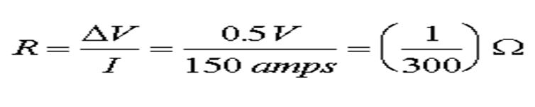
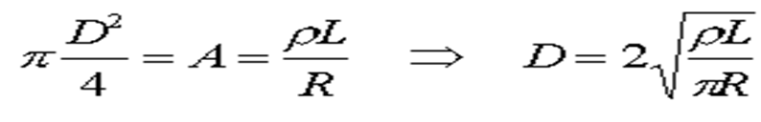
UNIT 1: Fundamentals of Electricity
DC Circuits
Conductivity
Solution:
The resistance of the wire needs to by less than the voltage drop divided by the current.
The resistance is given by R =ρL/A, therefore the cross-sectional area is:
D = 1.99 cm

Slide 22
UNIT 1: Fundamentals of Electricity
DC Circuits
Problem
A length of wire has a resistance of 4.5Ω. Find the resistance of another wire of the same material three times as long and twice the cross-sectional area.

Slide 23
UNIT 1: Fundamentals of Electricity
DC Circuits
Energy dissipation in resistors
As a charge q moves through a resistor, it loses a potential energy qV where V is the potential drop across the resistor. This energy goes into heat, much like the way a ball of putty that falls off a cliff converts its potential energy to heat when it hits the ground. We refer to this conversion of potential energy into heat as dissipation.

Slide 24
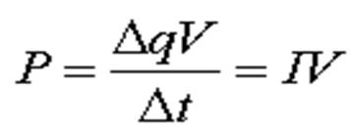
UNIT 1: Fundamentals of Electricity
DC Circuits
The power dissipated in a resistor is the energy dissipated per time. If an amount of charge Δq moves through the resistor in a time Δt, the power loss is
where I is the current through the resistor. This relation P=IV is correct for any component. For instance, in a battery the power generated by the battery is also IV where I and V are the current through and voltage across of the battery.

Slide 25
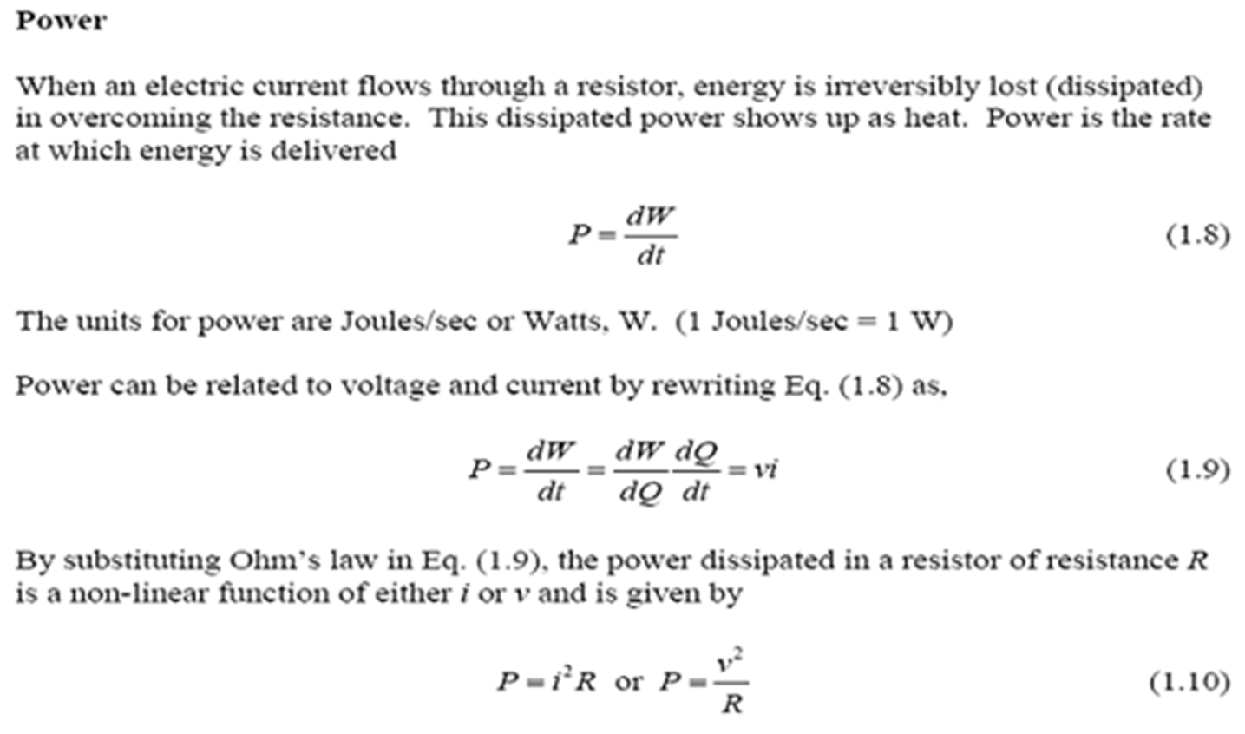
UNIT 1: Fundamentals of Electricity
DC Circuits

Slide 26
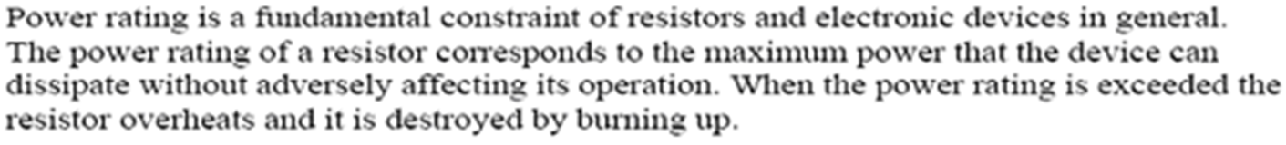
UNIT 1: Fundamentals of Electricity
DC Circuits
The energy consumed by an electrical appliance depends on its power rating and the length of time it is operating.

Slide 27
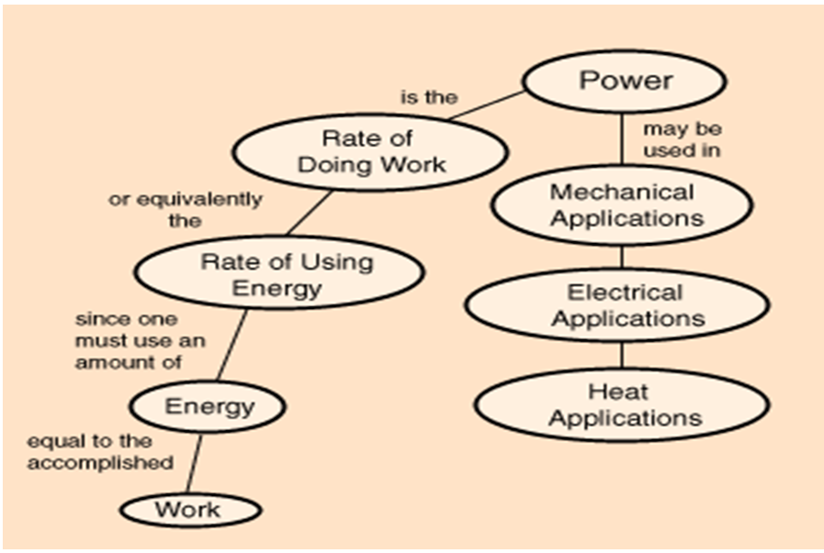
UNIT 1: Fundamentals of Electricity
DC Circuits

Slide 28
UNIT 1: Fundamentals of Electricity
DC Circuits
It may also be mentioned here that joule is also known as watt-second i.e. 1joule=1watt-sec. When we are dealing with large amount of electrical energy, it is often convenient to express it in kilowatt hours (KWh).
1KWh=1000 watt-hours=1000x3600 watt-sec or joules
1KWh=36x10 joules or watt-sec
Although practical unit of electrical energy is KWh, yet it is easy to see that this unit is readily convertible to joules with the help of the above relation.

Slide 29
UNIT 1: Fundamentals of Electricity
DC Circuits
Question #1:
The following are the details of load on a circuit connected through a supply meter for the month of June:
Six lamps of 40 watts each working for 4 hours per day
Two fluorescent tubes 125 watts each working for 2 hours per day
One 1000 watt heater working for 3 hours per day.
If each unit energy costs122 RWF, what will be the electricity bill for the month of June?

Slide 30
UNIT 1: Fundamentals of Electricity
DC Circuits
Question #2:
A 12-volt battery is used to heat a 120 ml cup of coffee by submerging an 8.0-ohm resistor. How long will take to bring the coffee from 20 ºC to 100 ºC?

Slide 31
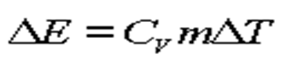
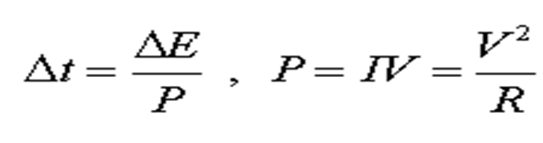
UNIT 1: Fundamentals of Electricity
DC Circuits
Solution: The energy needed to heat the water is:
where C_{v} is the specific heat, one calorie per gram, DT is the change in temperature and m is the mass, 120 g. One then obtains the energy, E = 9600 calories = 4.03E4 J. The time Dt can be found by
Δt = 37 minutes

Slide 32
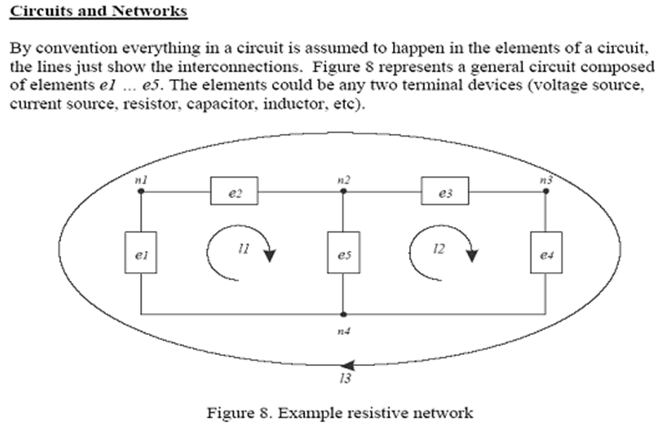
UNIT 1: Fundamentals of Electricity
DC Circuits

Slide 33
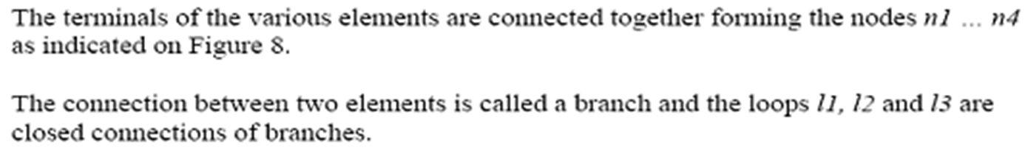
UNIT 1: Fundamentals of Electricity
DC Circuits

Slide 34
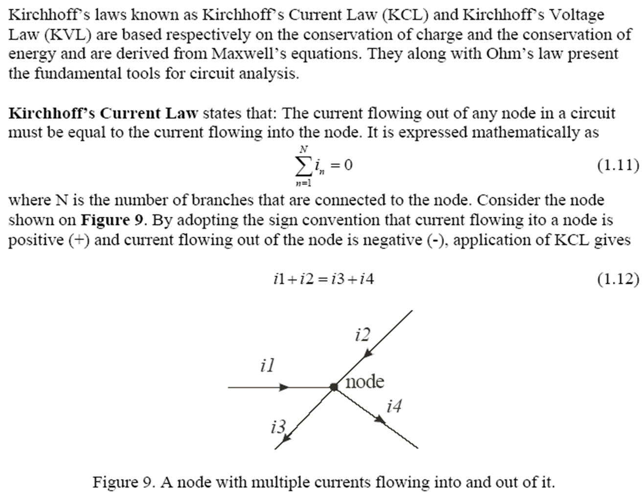
UNIT 1: Fundamentals of Electricity
Kirchhoff’s laws

Slide 35
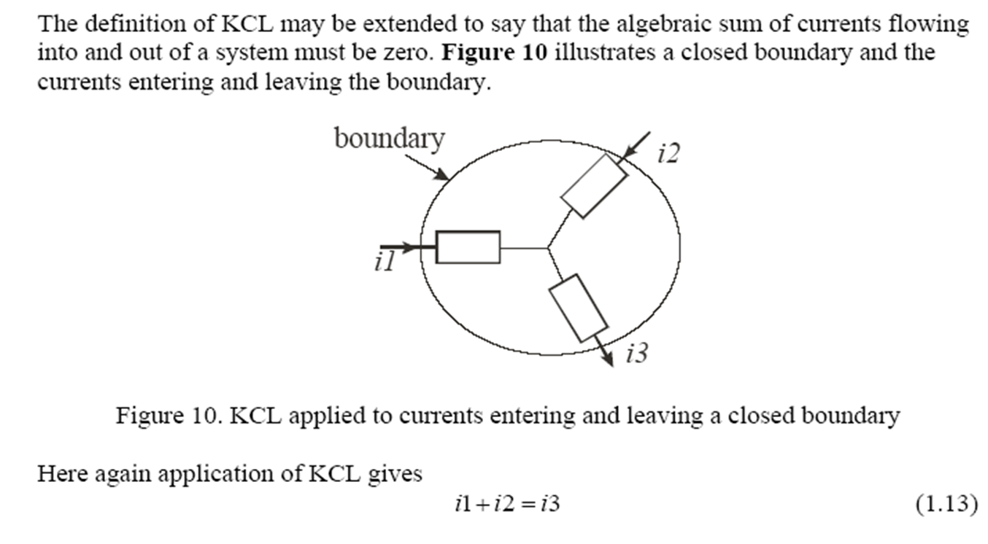
UNIT 1: Fundamentals of Electricity
Kirchhoff’s laws

Slide 36
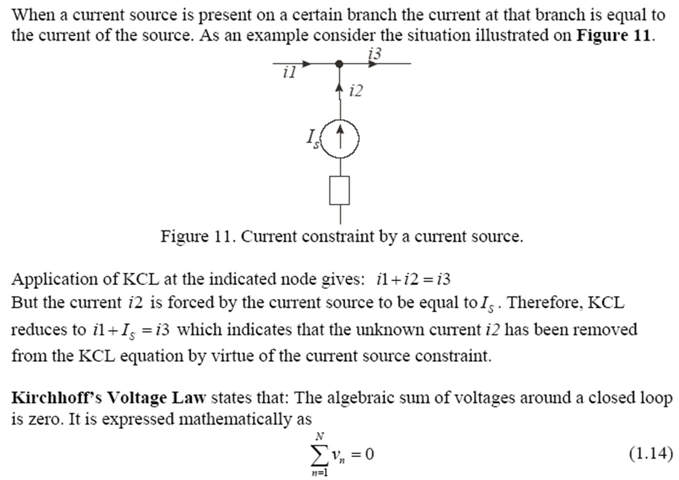
UNIT 1: Fundamentals of Electricity
Kirchhoff’s laws

Slide 37
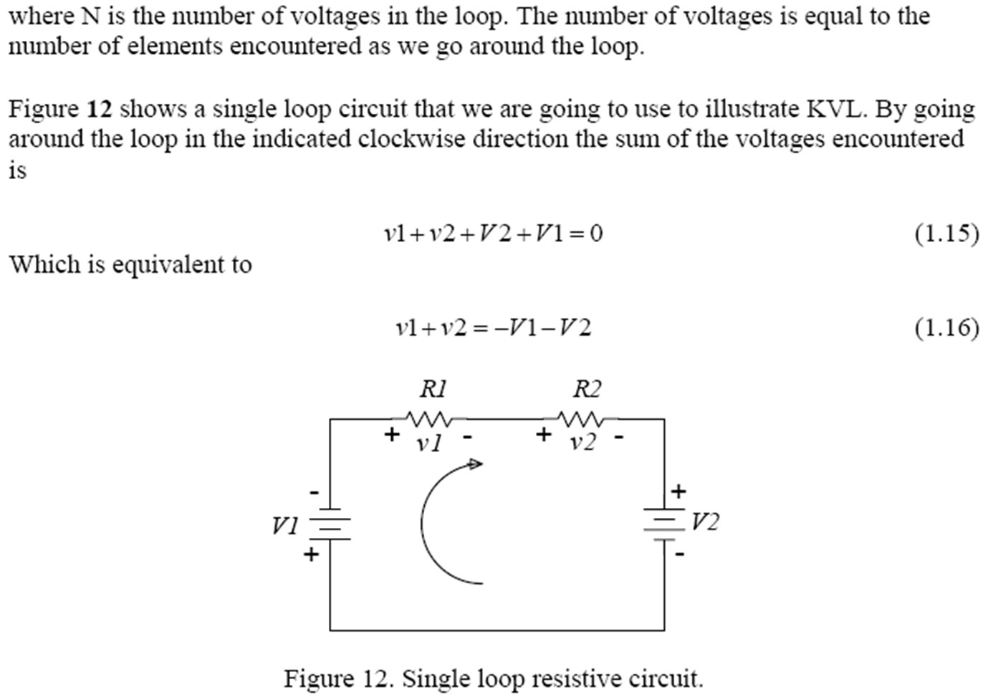
UNIT 1: Fundamentals of Electricity
Kirchhoff’s laws

Slide 38
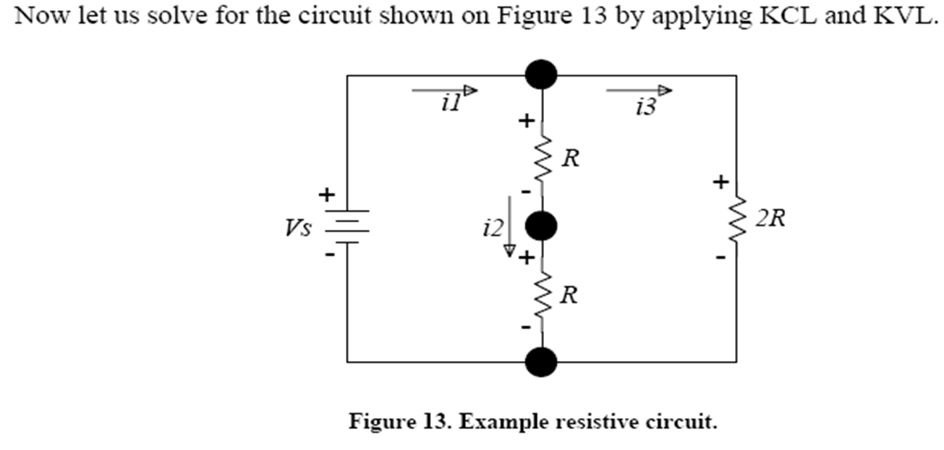
UNIT 1: Fundamentals of Electricity
Kirchhoff’s laws

Slide 39
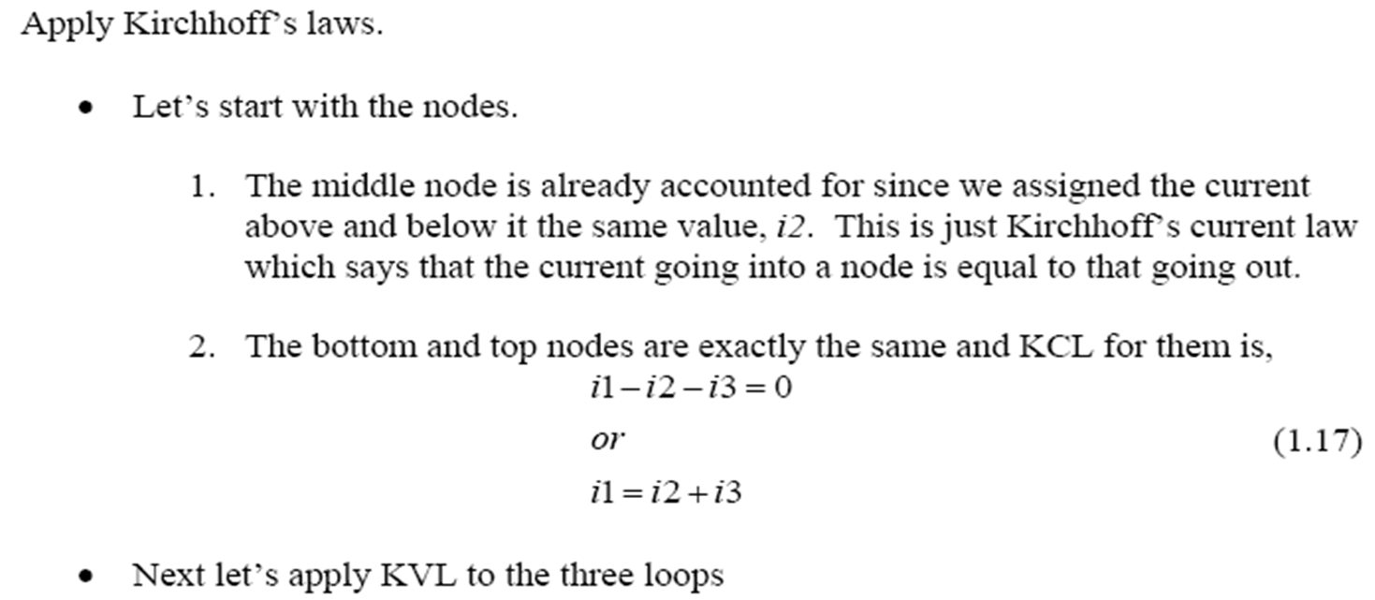
UNIT 1: Fundamentals of Electricity
Kirchhoff’s laws

Slide 40
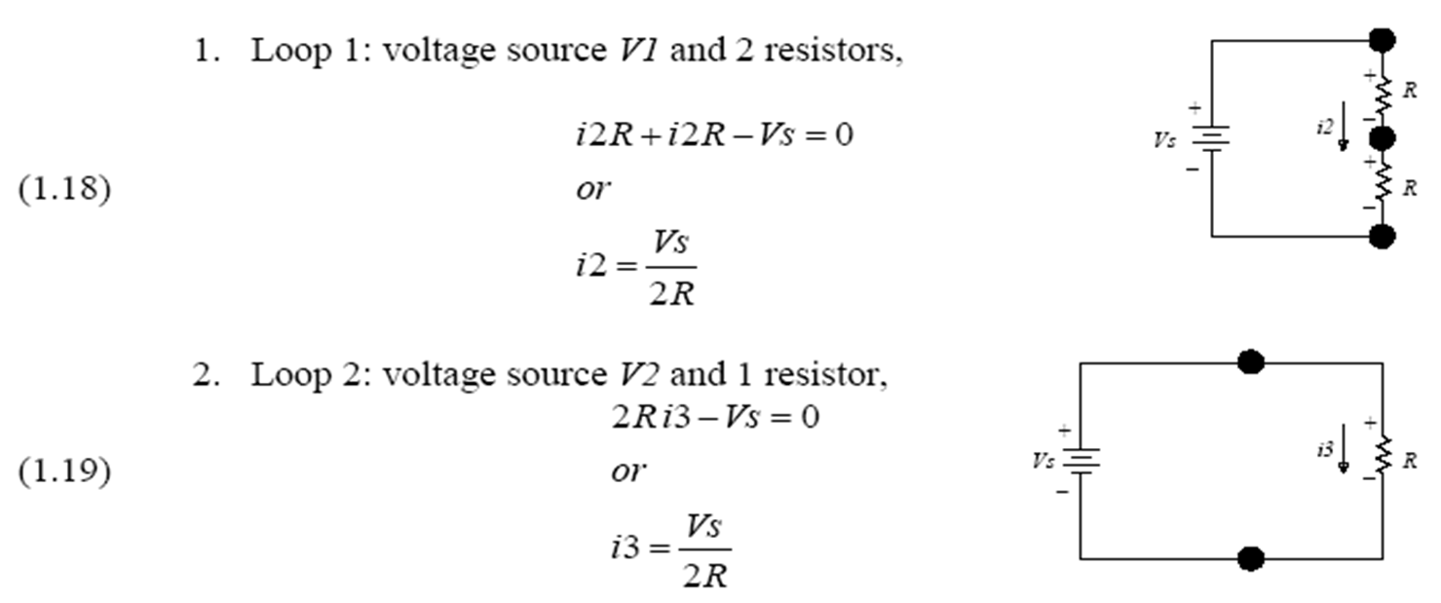
UNIT 1: Fundamentals of Electricity
Kirchhoff’s laws

Slide 41
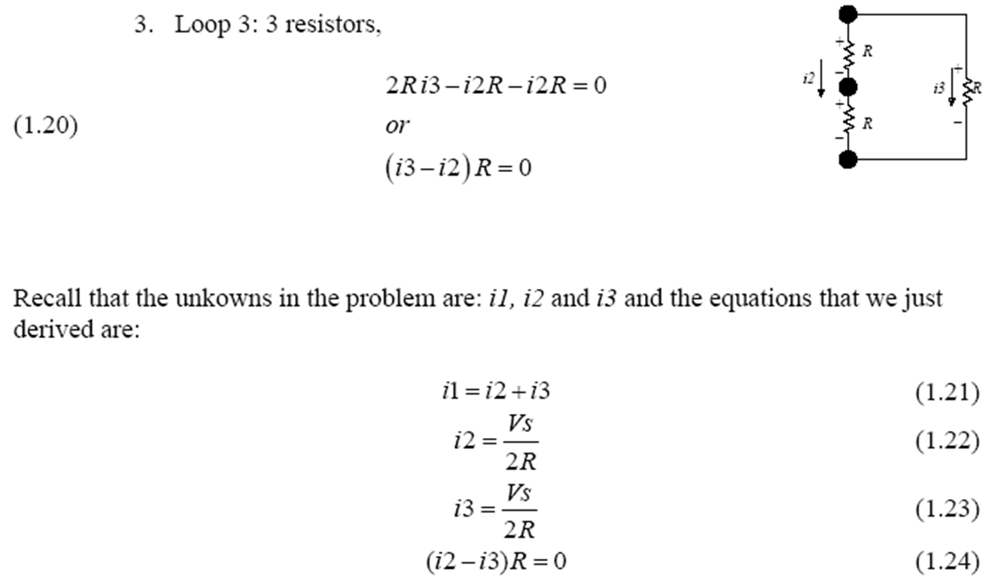
UNIT 1: Fundamentals of Electricity
Kirchhoff’s laws

Slide 42
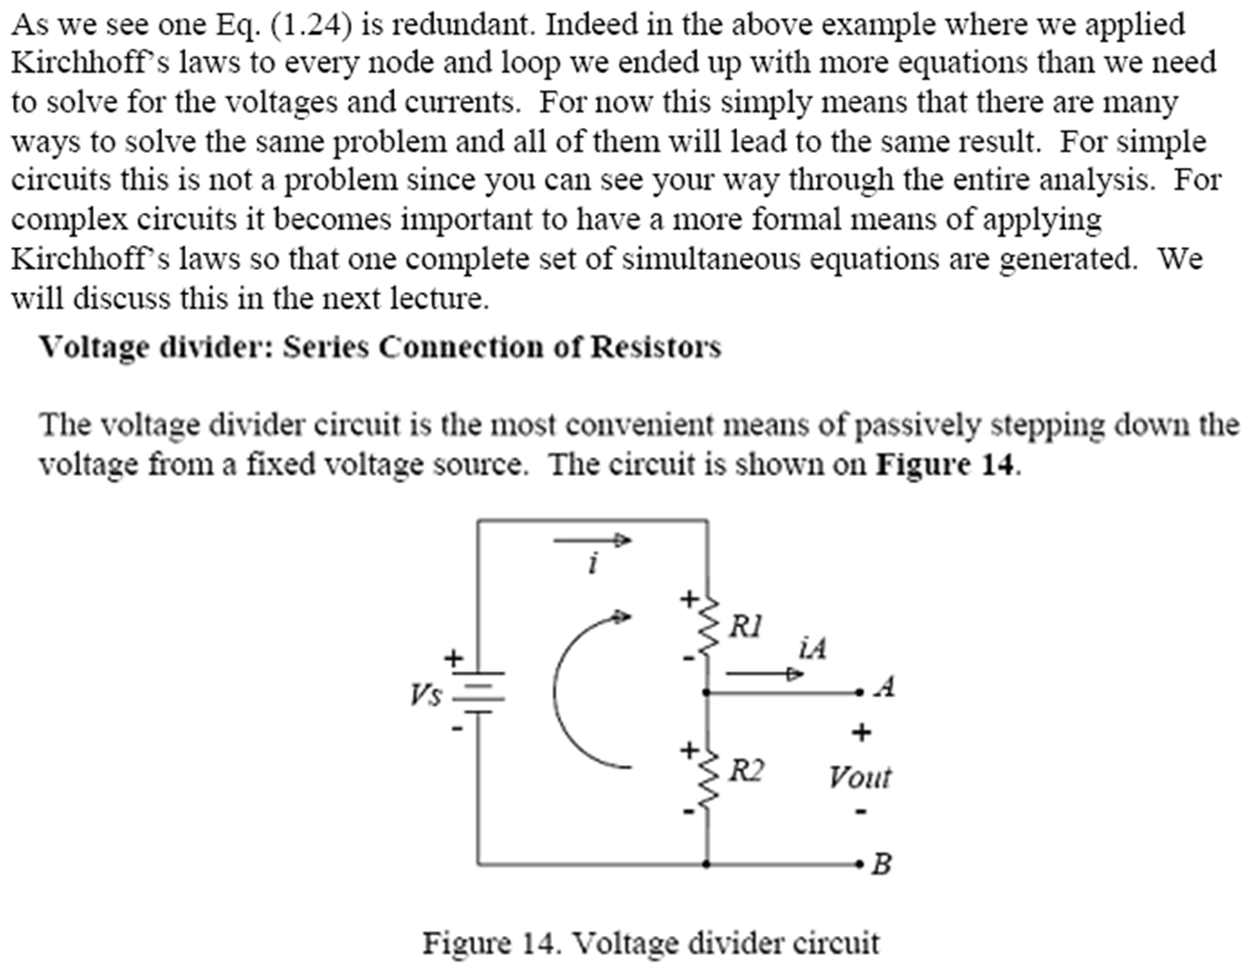
UNIT 1: Fundamentals of Electricity
Kirchhoff’s laws

Slide 43
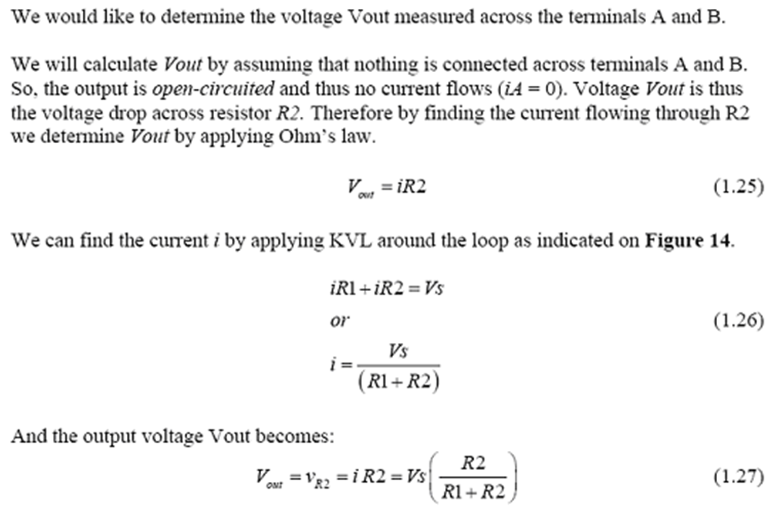
UNIT 1: Fundamentals of Electricity
Kirchhoff’s laws

Slide 44
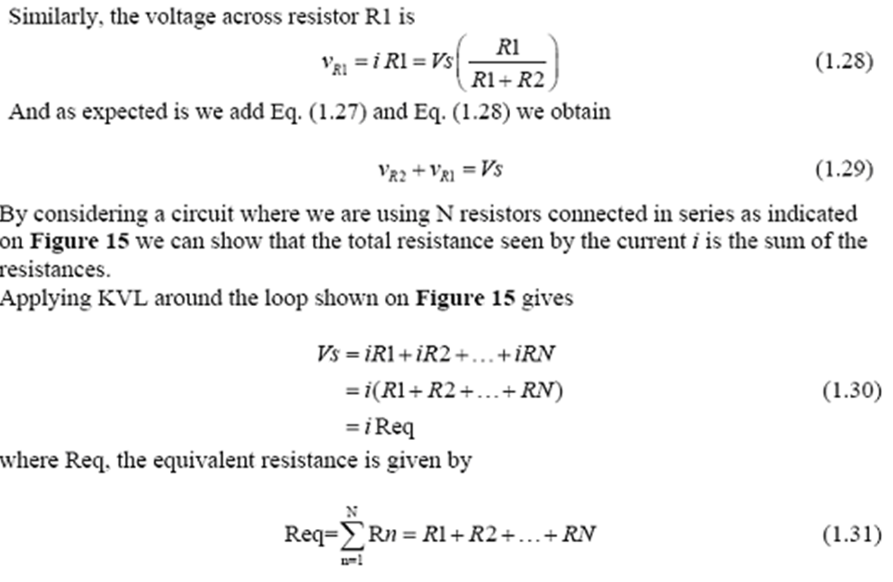
UNIT 1: Fundamentals of Electricity
Kirchhoff’s laws

Slide 45
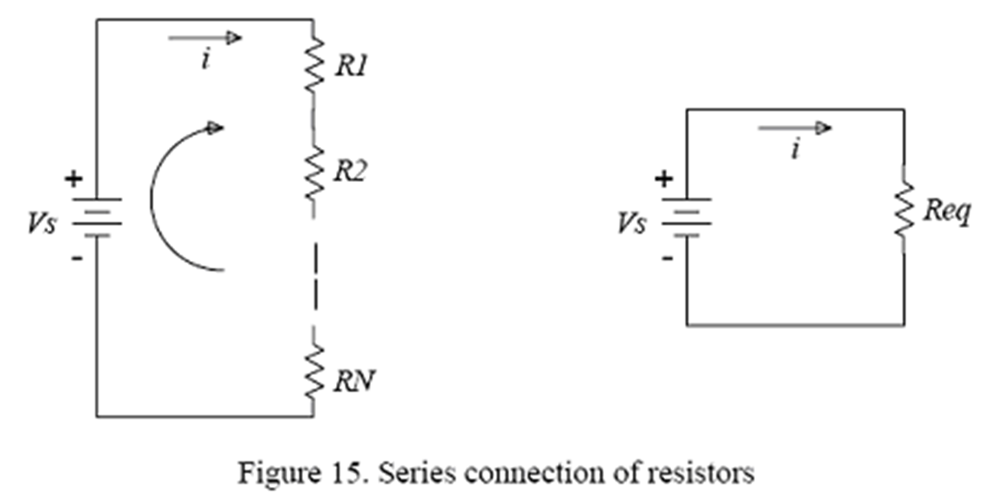
UNIT 1: Fundamentals of Electricity
Kirchhoff’s laws

Slide 46
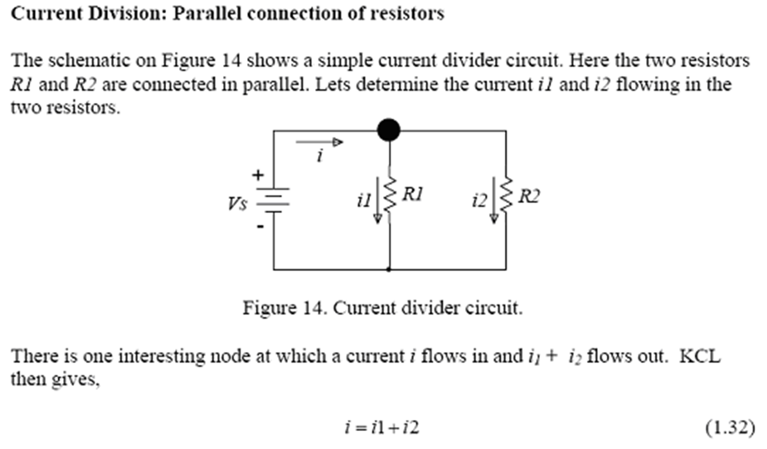
UNIT 1: Fundamentals of Electricity
Kirchhoff’s laws

Slide 47
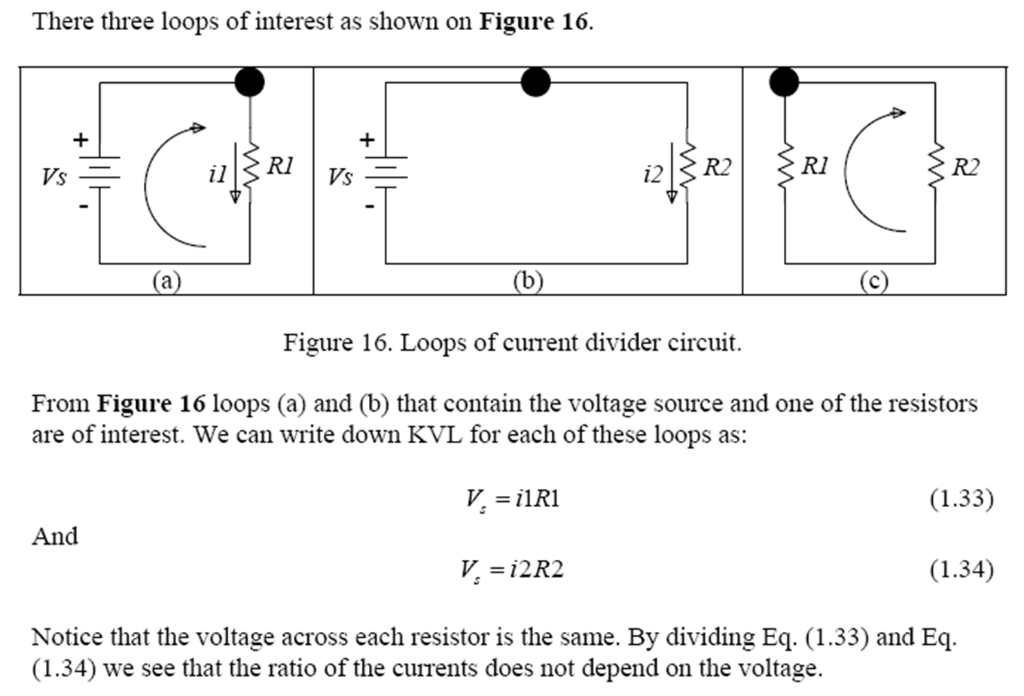
UNIT 1: Fundamentals of Electricity

Slide 48
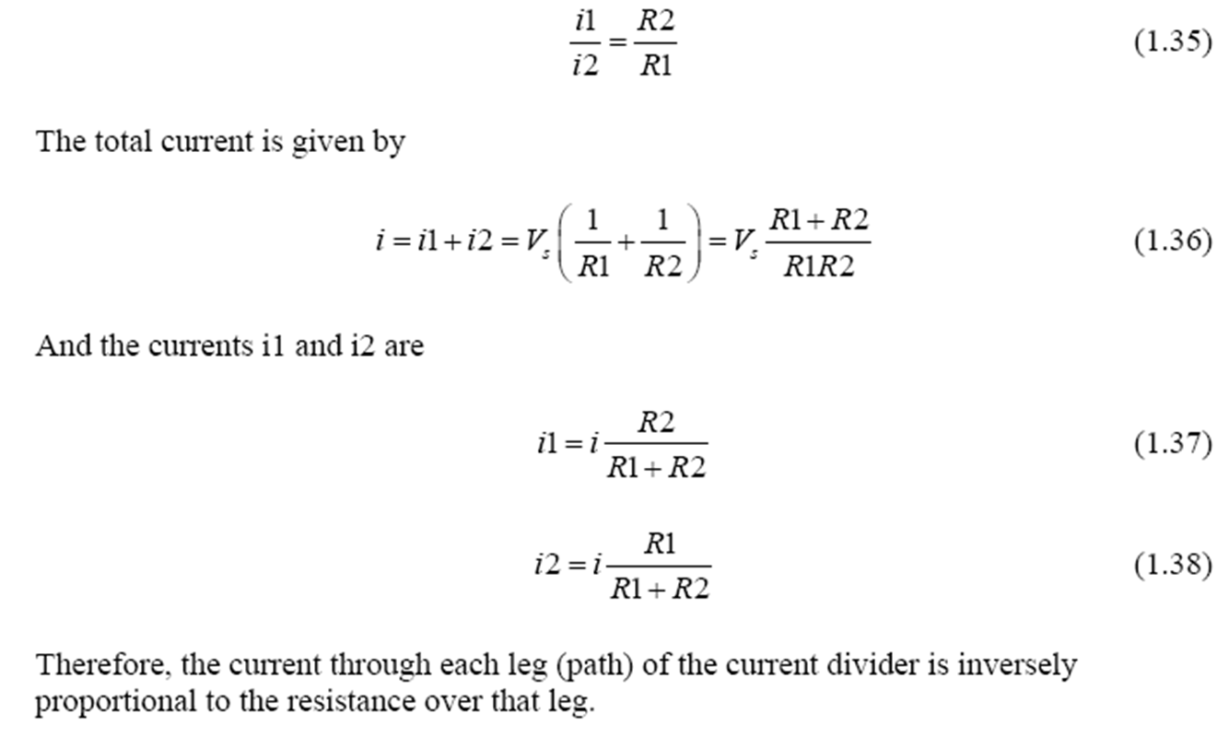
UNIT 1: Fundamentals of Electricity

Slide 49
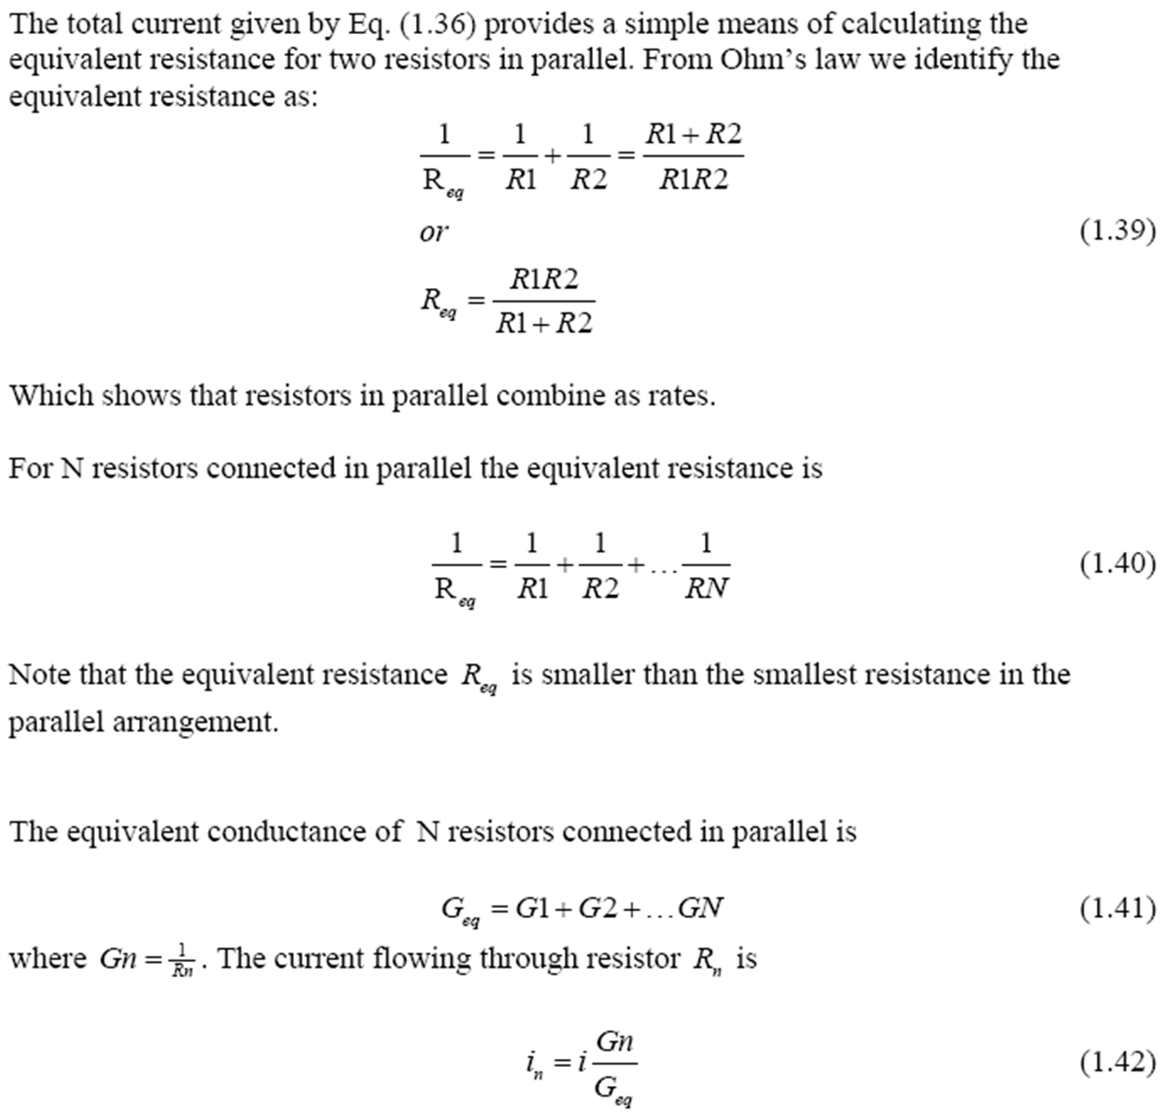
UNIT 1: Fundamentals of Electricity

Slide 50
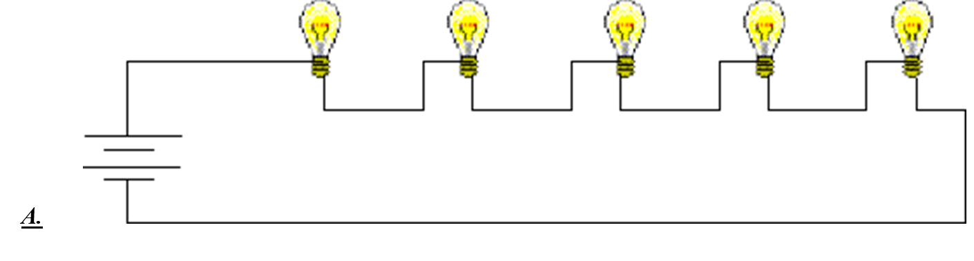
UNIT 1: Fundamentals of Electricity
Question #1
Which of the two circuit diagrams below best represents the way one would wire a house?

Slide 51
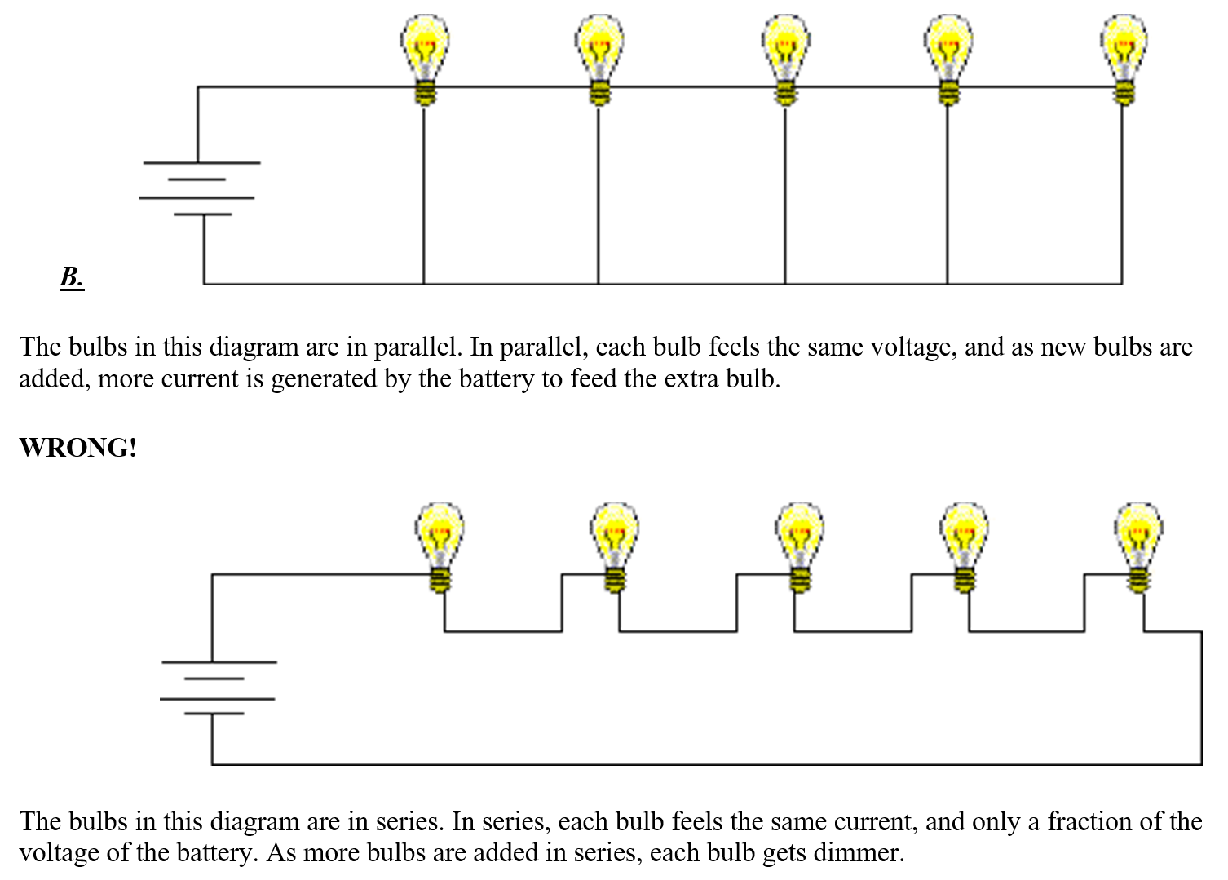
UNIT 1: Fundamentals of Electricity

Slide 52
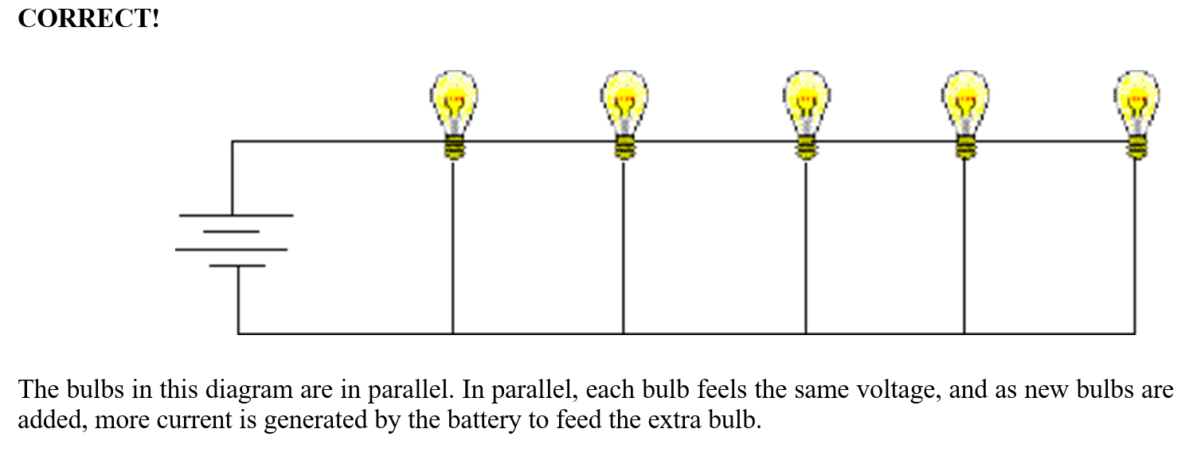
UNIT 1: Fundamentals of Electricity

Slide 53
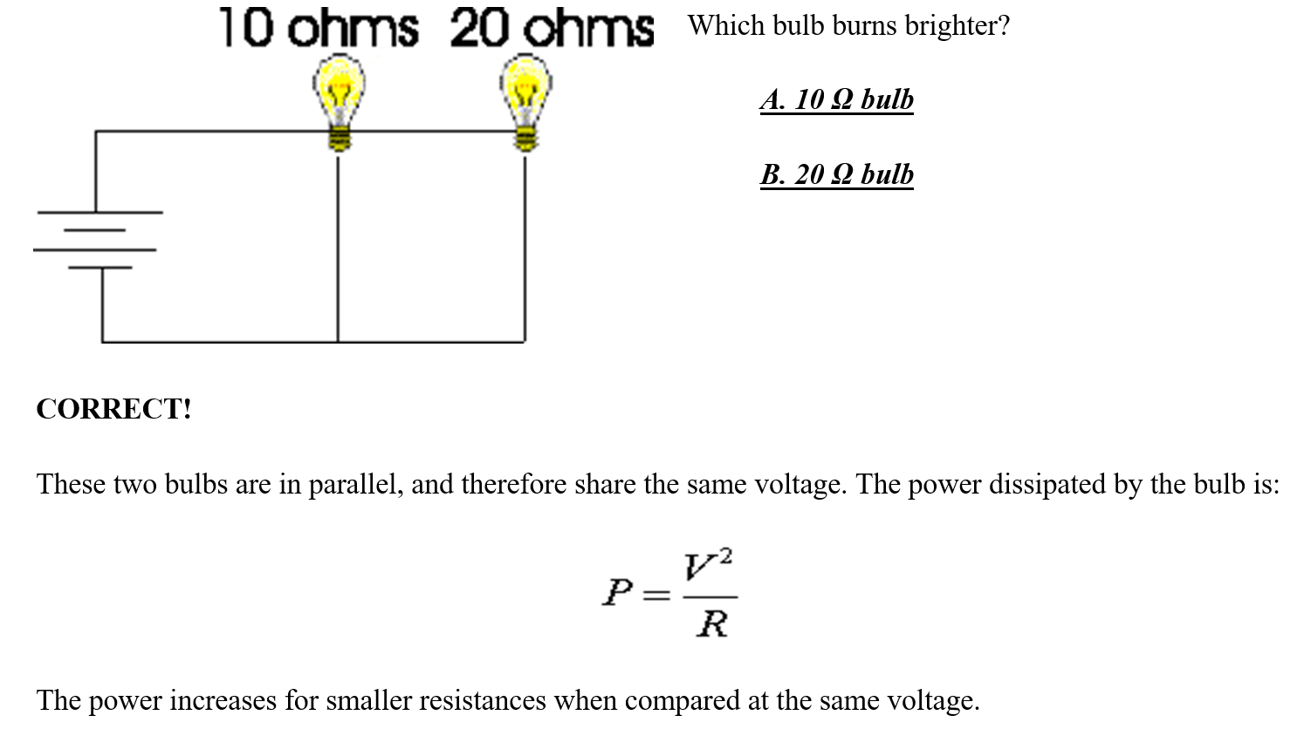
UNIT 1: Fundamentals of Electricity
Question #2

Slide 54
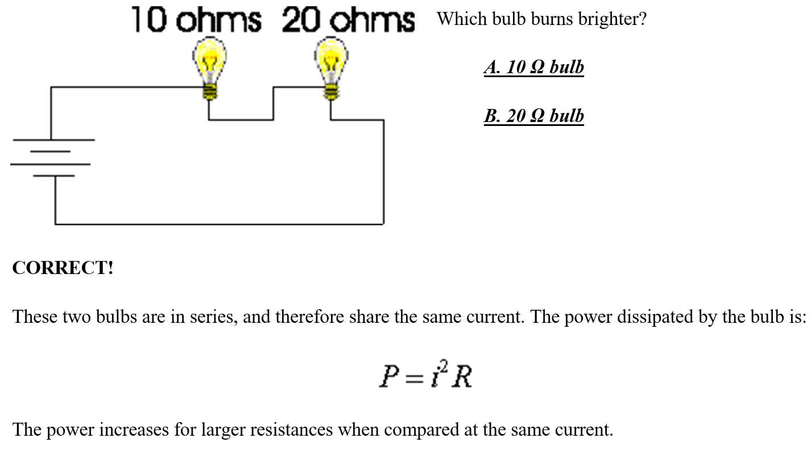
UNIT 1: Fundamentals of Electricity
Question #3

Slide 55
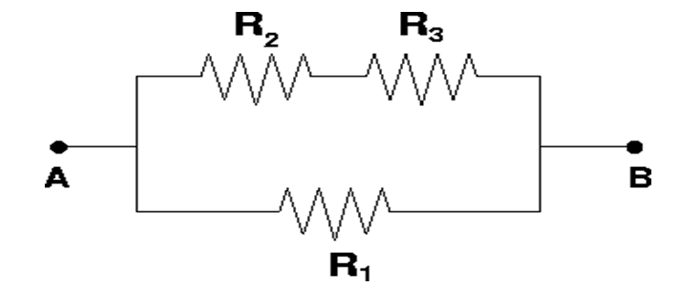
UNIT 1: Fundamentals of Electricity
Question #4
Consider the circuit below. What is the equivalent resistance R_{ab}?
DATA: R1 = R2 = R3 = 7.0 Ω
Solution:
First consider the upper two resistors as a single resistor, R23. The resistance RAB can be found by adding R1 and R23 in parallel.

Slide 56
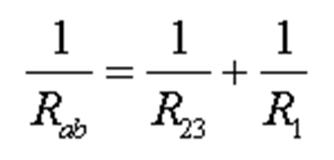
UNIT 1: Fundamentals of Electricity
Question #4
Adding one 1/14 and 1/7 gives 3/14, therefore
RAB = (14/3) Ω

Slide 57
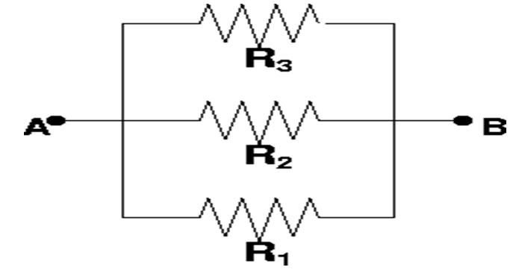
UNIT 1: Fundamentals of Electricity
Question #5
What is the equivalent resistance RAB of the three resistors shown below.
Data R1 = R2 = R3 = 6 Ω.

Slide 58
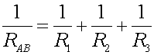
UNIT 1: Fundamentals of Electricity
Solution:
R_{AB} = 2 Ω

Slide 59

UNIT 1: Fundamentals of Electricity
Question #6:

Slide 60

UNIT 1: Fundamentals of Electricity
Question #6:

Slide 61

UNIT 1: Fundamentals of Electricity
Question #6:

Slide 62

UNIT 1: Fundamentals of Electricity

Slide 63

UNIT 1: Fundamentals of Electricity

Slide 64

UNIT 1: Fundamentals of Electricity
Question #7
Find the currents through all the resistors in the circuit below:
DATA: Vb = 12 V, R1 = 10 Ω, R2 = 15 Ω, R3 = 20 Ω

Slide 65

UNIT 1: Fundamentals of Electricity
Solution:

Slide 66

UNIT 1: Fundamentals of Electricity
Question #8:

Slide 67
UNIT 1: Fundamentals of Electricity
Note: The direction of a current and the polarity of a voltage source can be assumed arbitrarily. To determine the actual direction and polarity, the sign of the values also should be considered. For example, a current labeled in left-to-right direction with a negative value is actually flowing right-to-left.
The Branch-Current Method:
Step 1: Label each unknown current arbitrarily with a reference direction. If the calculated value is negative, the actual direction of the current is opposite to the reference direction.
Step 2: Define unknown voltages in terms of the assumed currents to obtain three element equations:

Slide 68

UNIT 1: Fundamentals of Electricity

Slide 69
UNIT 1: Fundamentals of Electricity
But this equation is not independent as it can be obtained as the difference between the previoius two equations. The above three independent equations (one for current, two for voltage) are called connection equations.
Step 5: We have six simultaneous equations (three element equations and three connection equations) for six unknowns (three currents and three voltages). Substitute the three element equations into the two voltage connection equations:

Slide 70

UNIT 1: Fundamentals of Electricity

Slide 71

UNIT 1: Fundamentals of Electricity

Slide 72


UNIT 1: Fundamentals of Electricity
Question #9: Solve the following circuit

Slide 73


UNIT 1: Fundamentals of Electricity
Loop current method:

Slide 74

UNIT 1: Fundamentals of Electricity
Question # 10: Calculate the current in 5Ω resistor shown in the figure below:

Slide 75

UNIT 1: Fundamentals of Electricity
DC Network Theorems

Slide 76

UNIT 1: Fundamentals of Electricity
DC Network Theorems

Slide 77

UNIT 1: Fundamentals of Electricity
DC Network Theorems

Slide 78

UNIT 1: Fundamentals of Electricity
DC Network Theorems

Slide 79

UNIT 1: Fundamentals of Electricity
DC Network Theorems

Slide 80

UNIT 1: Fundamentals of Electricity
DC Network Theorems

Slide 81

UNIT 1: Fundamentals of Electricity
DC Network Theorems

Slide 82

UNIT 1: Fundamentals of Electricity
DC Network Theorems

Slide 83

UNIT 1: Fundamentals of Electricity
DC Network Theorems

Slide 84

UNIT 1: Fundamentals of Electricity
DC Network Theorems

Slide 85

UNIT 1: Fundamentals of Electricity
Thevenin equivalemt circuits

Slide 86

UNIT 1: Fundamentals of Electricity
Thevenin equivalent circuits

Slide 87

UNIT 1: Fundamentals of Electricity
Thevenin equivalent circuits

Slide 88

UNIT 1: Fundamentals of Electricity
Thevenin equivalent circuits

Slide 89

UNIT 1: Fundamentals of Electricity
Thevenin equivalent circuits

Slide 90

UNIT 1: Fundamentals of Electricity
Thevenin equivalent circuits

Slide 91

UNIT 1: Fundamentals of Electricity
Thevenin equivalent circuits

Slide 92

UNIT 1: Fundamentals of Electricity
Thevenin equivalent circuits

Slide 93

UNIT 1: Fundamentals of Electricity
Thevenin equivalent circuits

Slide 94

UNIT 1: Fundamentals of Electricity

Slide 95

UNIT 1: Fundamentals of Electricity

Slide 96

UNIT 1: Fundamentals of Electricity

Slide 97

UNIT 1: Fundamentals of Electricity

Slide 98

UNIT 1: Fundamentals of Electricity

Slide 99

UNIT 1: Fundamentals of Electricity

Slide 100

UNIT 1: Fundamentals of Electricity

Slide 101

UNIT 1: Fundamentals of Electricity

Slide 102

UNIT 1: Fundamentals of Electricity

Slide 103

UNIT 1: Fundamentals of Electricity

Slide 104

UNIT 1: Fundamentals of Electricity

Slide 105

UNIT 1: Fundamentals of Electricity

Slide 106

UNIT 1: Fundamentals of Electricity

Slide 107

UNIT 1: Fundamentals of Electricity

Slide 108

UNIT 1: Fundamentals of Electricity

Slide 109

UNIT 1: Fundamentals of Electricity

Slide 110

UNIT 1: Fundamentals of Electricity

Slide 111

UNIT 1: Fundamentals of Electricity

Slide 112

UNIT 1: Fundamentals of Electricity

Slide 113

UNIT 1: Fundamentals of Electricity
EXERCISES
1. Find the current in the 4Ω resistance in figure below using the principle of superposition.

Slide 114

UNIT 1: Fundamentals of Electricity
EXERCISES
2. Using Thevenin’s theorem, find the current in 8Ω resistor in figure below. Given that battery has an internal resistance of 1Ω.

Slide 115

UNIT 1: Fundamentals of Electricity
EXERCISES
3. Using Norton’s theorem, find the current in 8Ω resistor of the network shown in figure below:

Slide 116

UNIT 1: Fundamentals of Electricity
EXERCISES
4. Calculate the value of load resistance to which maximum power may be transferred from the circuit shown in figure below. Determine also the value of maximum power.

Slide 117

UNIT 1: Fundamentals of Electricity
EXERCISES
5. Find the voltage vo using the principle of superposition.

Slide 118

UNIT 1: Fundamentals of Electricity
EXERCISES
6. Calculate io for the circuit below using the principle of superposition.

Slide 119

UNIT 1: Fundamentals of Electricity
EXERCISES
7. Using the principle of superposition, calculate io and vo as indicated in the circuit below.

Slide 120
END!!!

